Slide 1
Diabetes Prediction Using BRFSS Dataset
Shreyoshi Ghosh

Slide 2
Data Background
Subset of data taken from 2015 BRFSS annual survey
Only features that are relevant to diabetes detection
253,680 survey responses
22 variables, including diabetes diagnosis
Mostly categorical variables, except for one: BMI
Notes:
The data is a part of the 2015 Behavioral Risk Factor Surveillance System annual survey done by the CDC. The survey is comprised of multiple choice questions, which I encoded into categorical variables. I then consolidated the original dataset to include only the columns he determined to be relevant to diabetes detection. The original dataset contains responses from 441,455 individuals and has 330 features, while the dataset I used is comprised of 253,680 responses and 22 variables total. The features consist of things like high cholesterol or blood pressure, smoker status, age, BMI, sex and income. All of the features are categorical, ranging from binary to 30, except for BMI.
I am using two different versions of the dataset, one binary which contains diabetic (which is a combination of pre-diabetic and diabetic) & non-diabetic, and one multiclass which separates the three.

Slide 3
Project Goals
Binary Classification
Distinguish between non-diabetic and diabetic
Multi-Class Classification
Distinguish between non-diabetic, pre-diabetic and diabetic.
Notes:
My goal for this project was to train two classifiers to predict diabetes, one binary and one multi-class.

Slide 4
Exploratory Data Analysis
High correlation (label vs features)
Heavy imbalance
No Nulls
Keep duplicates
Notes:
The dataset has a large imbalance, with over a 6:1 ratio of non-diabetic to diabetic. This can impact the results as the model will be much better trained on non diabetic compared to diabetic/pre-diabetic. This could lead to false negatives, in which someone who should be categorized as 1 (diabetic), may be categorized as 0. Because of this, I oversampled the diabetic&prediabetic records using SMOTE.
The dataset I used was cleaned, so there were no nulls. There are duplicates in the dataset but I decided not to remove them, as with a medical dataset like this, each record is valuable in training the model. Also, duplicate records do not necessarily indicate error in this case as some individuals may have the same records.
I looked at the correlation scores of each feature with the label, and all of them seem to be correlated with the label, with the lowest correlation being with the feature that indicates if the patient had healthcare or not.
The correlation scores were not definitive enough, so I decide to use the chi2 test with an alpha of 0.01 to determine the feature importance. This resulted in all features except one being significant.

Slide 5
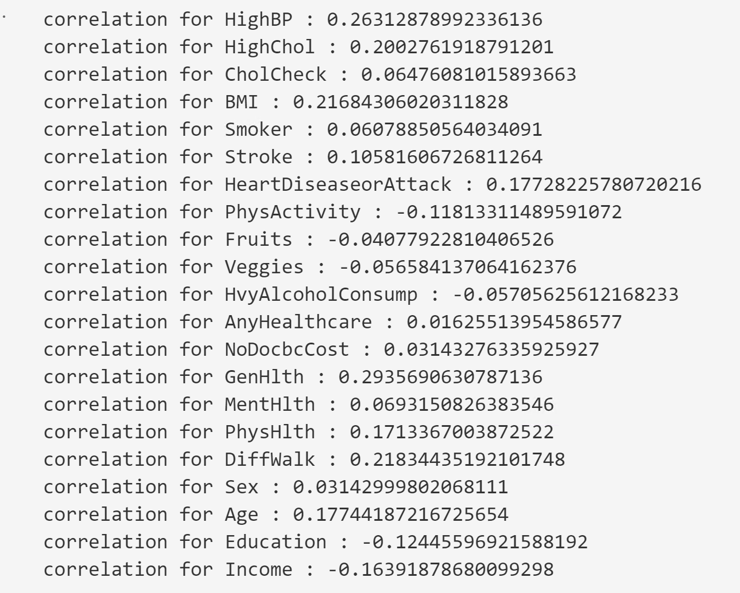
Exploratory Data Analysis
Notes:
Correlation scores for each column

Slide 6
Modeling Strategy
Build baseline classifiers for both binary and multiclass data sets
Random Forest
Histogram-based Gradient Boosting Classification Tree
Feature Selection
Chi2, α = 0.01
Tune hyperparameters
Which params?
Use cross validation
Choice of metric: weighted F1 score
Notes:
The plan for this project was to build baseline classifiers for both the binary and multiclass datasets. I decided on using RandomForest and HistGradientBoost, which is much faster than GradientBoostingClassifier for big datasets (n_samples >= 10 000). I decided to go with tree based models because they deal with categorical variable better and prevent me from having to one hot encode.
I split the data using a 20% test size and stratified with label column. I then did feature selection using chi2 and an alpha value of 0.01 to transform the training data, which resulted in one dropped feature (healthcare).
I then used gridsearch to tune the hyperparameters for each model. For the random forest models, I tuned the number of estimators, max depth of each tree, and max features (which determines what portion of the total features are used to randomly train each tree) . For the HistGradientBoost, I tuned the max itererations, max depth, minimum samples per leaf, and learning rate parameters. I used a 5 fold cross validation and the f1 weighted metric. I chose this metric because accuracy is not very reliable for imbalanced data sets and precision + recall are better measures. The F1 score is a harmonic mean of the precision and recall, with its best value at 1 and worst score at 0. I chose the weighted version to provide the correct weights to the imbalanced classes.

Slide 7
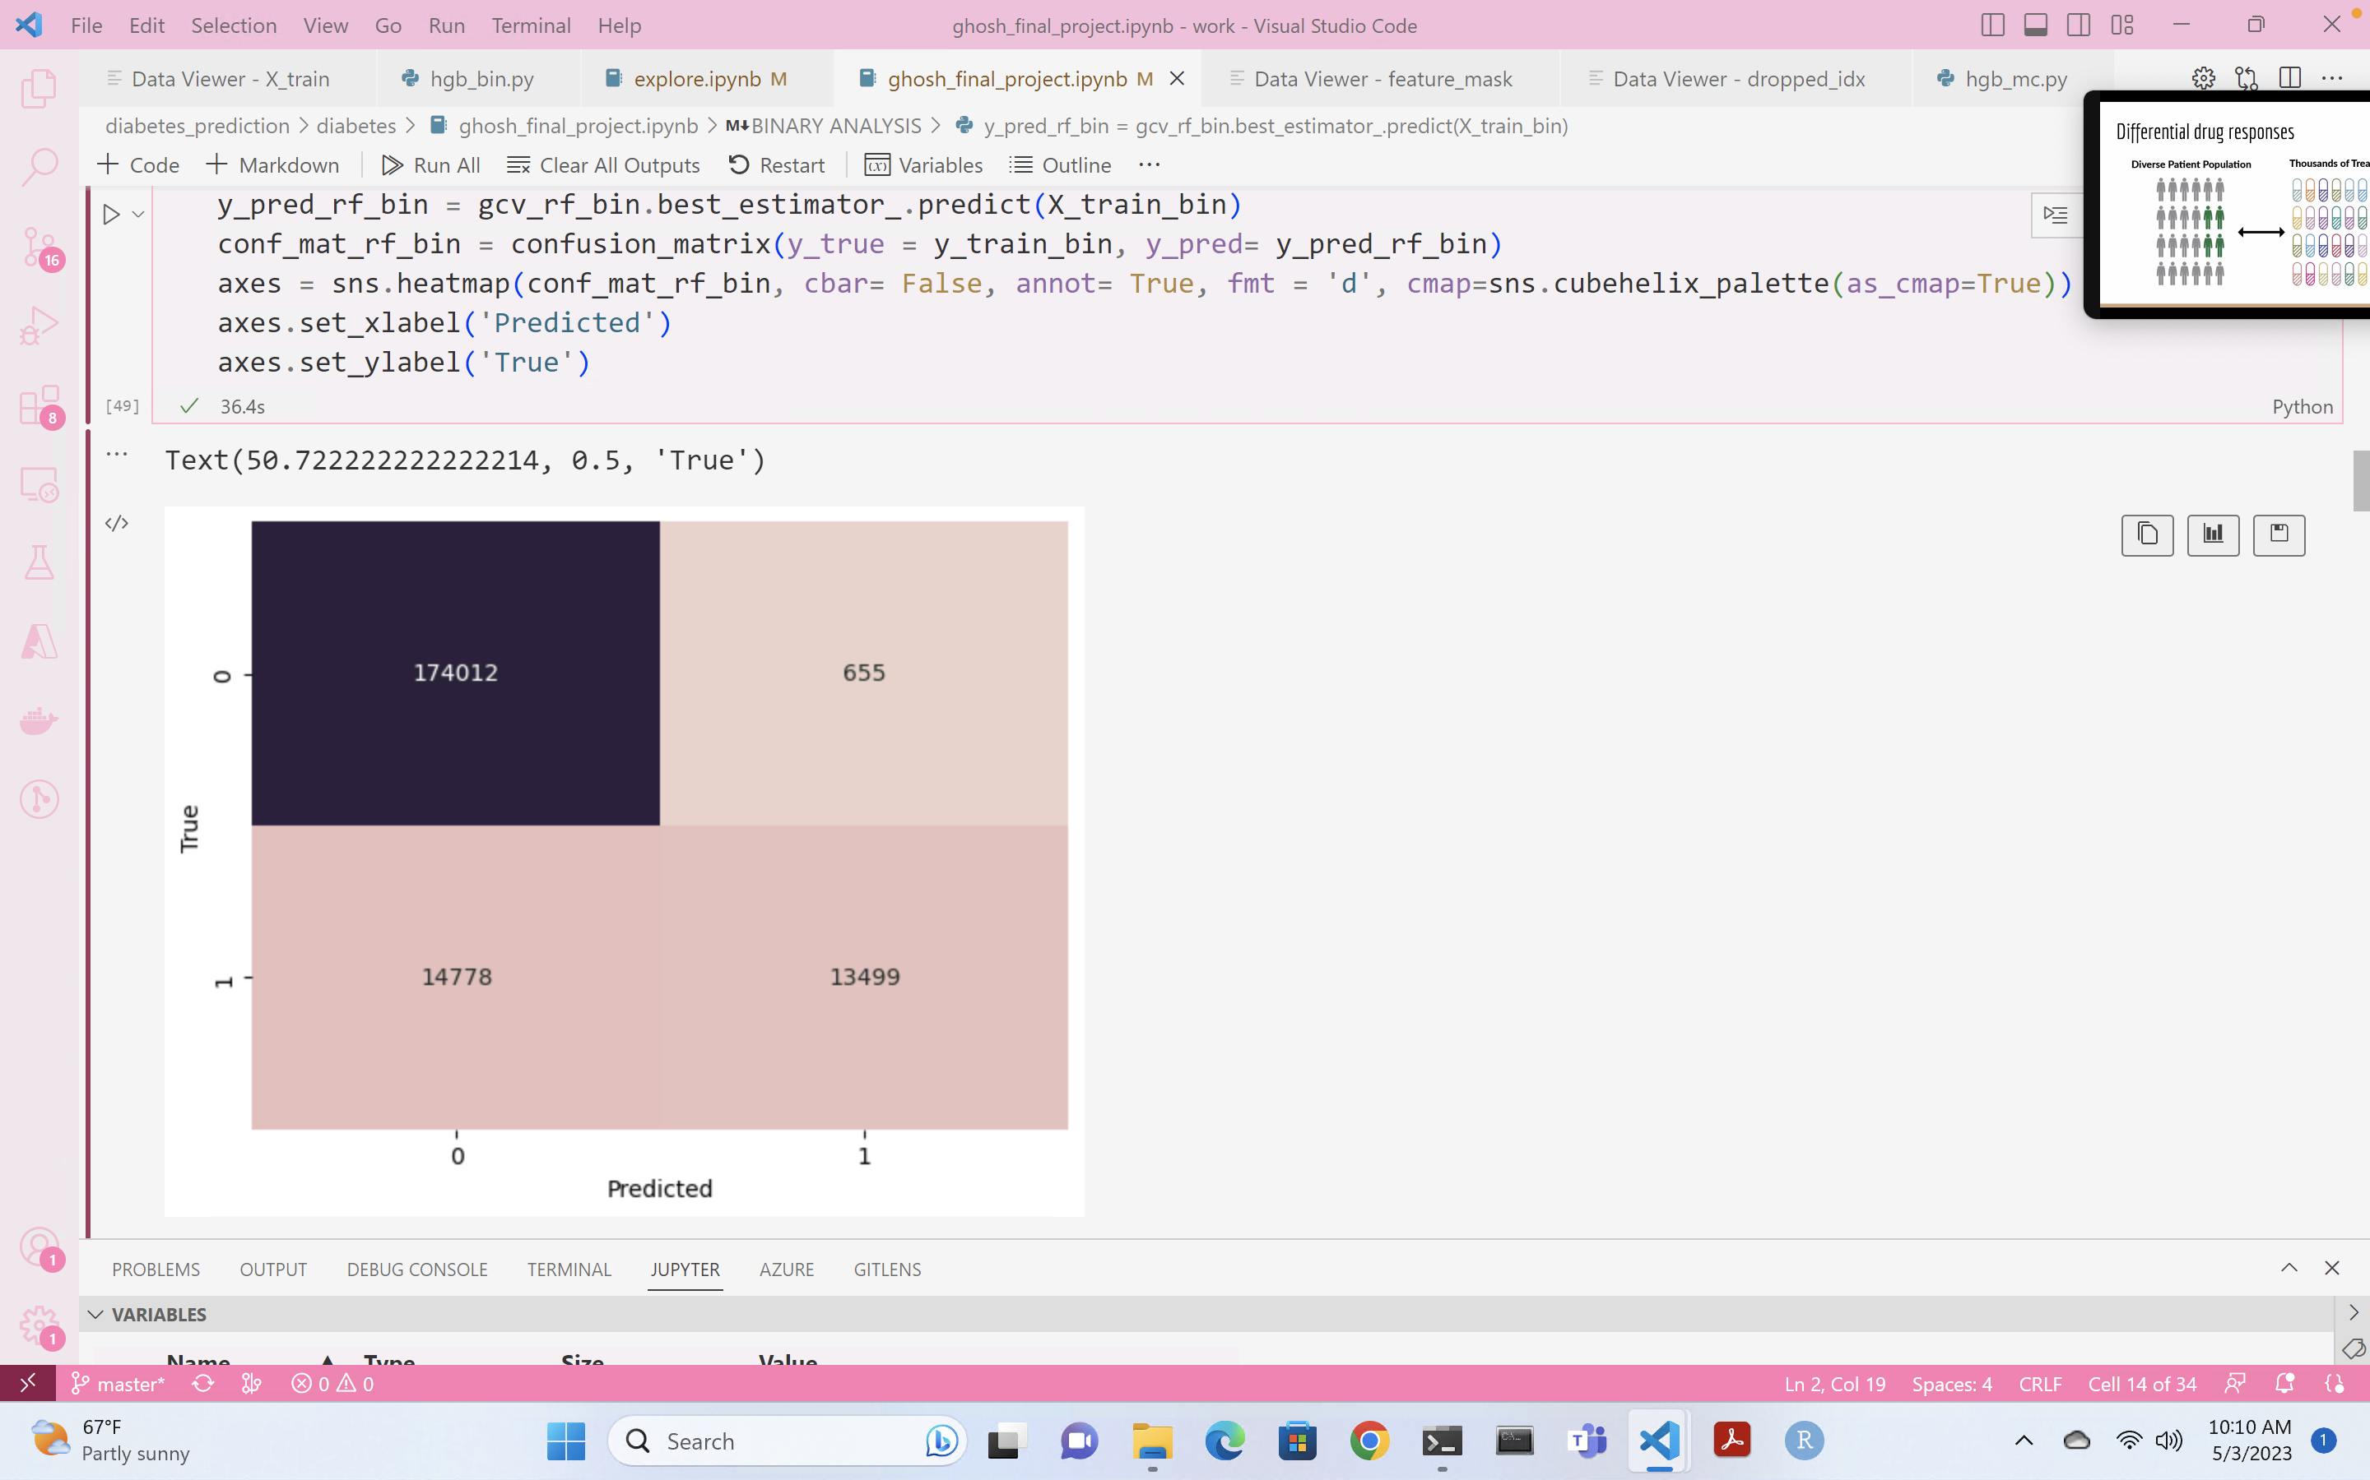
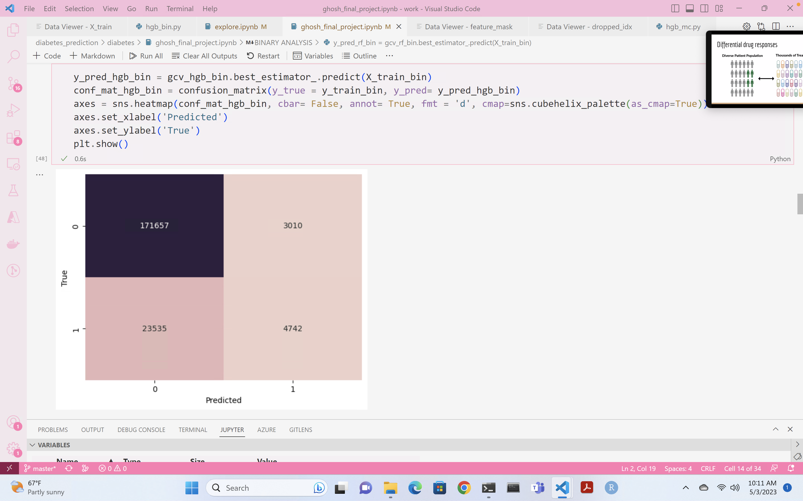
Binary Modeling Results
Random Forest
Best validation F1 score : 0.8326
Best training F1 score: 0.9214
Best hyperparameters: {'max_depth': 16, 'max_features': 0.5, 'n_estimators': 1000}
Gradient Boosting
Best validation F1 score: 0.8325
Best training F1 score: 0.8371
Best hyperparameters: {'learning_rate': 0.1, 'max_depth': 13, 'max_iter': 1000, 'min_samples_leaf': 80}

Slide 8
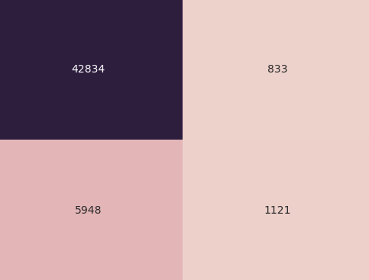
Binary Test Results
Gradient Boosting Test Results
Weighted F1 score: 0.83216

Slide 9
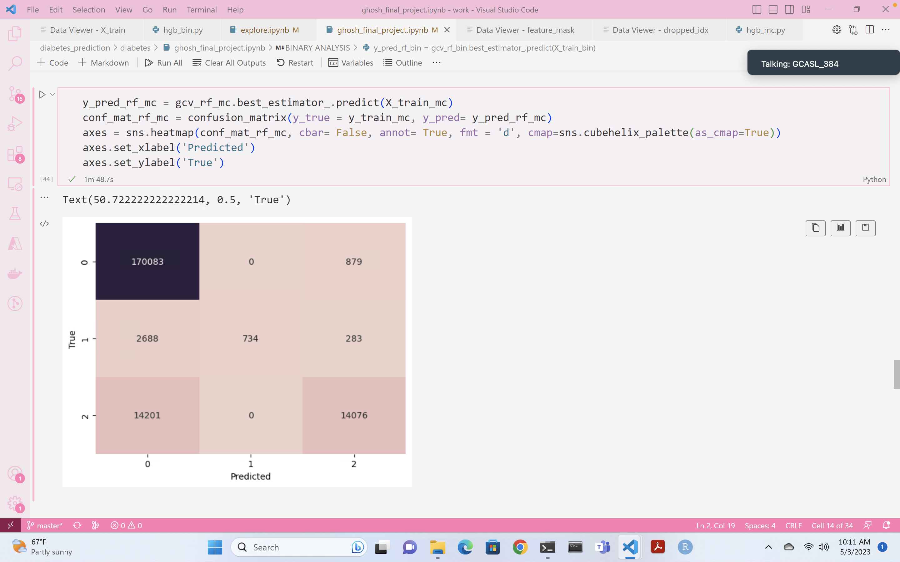
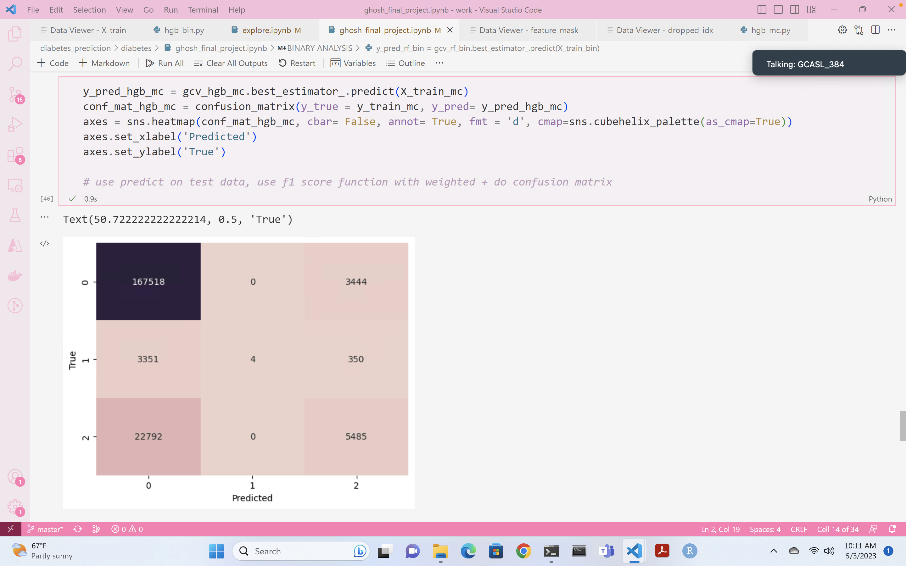
Multi-Class Modeling Results
Random Forest
Best validation F1 score: 0.8106
Best training F1 score: 0.9059
Best hyperparameters: {'max_depth': 16, 'max_features': 0.5, 'n_estimators': 3000}
Gradient Boosting
Best validation F1 score: 0.8118
Best training F1 score: 0.8172
Best hyperparameters: {'learning_rate': 0.1, 'max_depth': 16, 'max_iter': 1000, 'min_samples_leaf': 60}

Slide 10
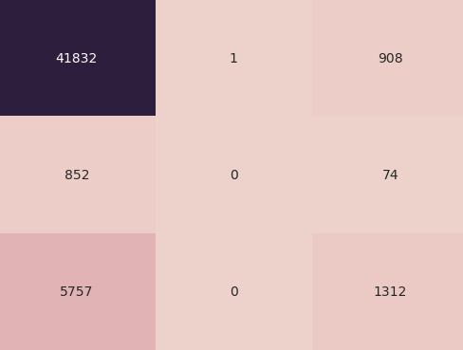
Multi-Class Test Results
Gradient Boosting Test Results
Weighted F1 score: 0.81201

Slide 11
Discussion/ Future Work
More data
Different/additional features?
Notes:
I started with the hypothesis that I can build a diabetes classifier for both the binary and multiclass diabetes datasets. The results of this project show that it is possible, but I definitely think that there is room for improvement. Correcting the data imbalance would be the first thing I would do.
I would investigate acquiring additional data, whether it be more samples or more features. I would also consider changing the variables taken from the original dataset and see if any were left out that could potentially better the model. There are also surveys from other years which could be used for additional data.

Slide 12
Thank
You!

